Slide 1

The National University of Computer and Emerging Sciences
Repetition structures
CS 1002 Programming Fundamentals
Dr. Akhtar Jamil
Department of Computer Science

Slide 2
Goals
Review Of Previous Lecture
Repetition structures
While
Do – While
For
Nesting

Slide 3
Previous Lecture

Slide 4
Switch - Syntax
switch (Variable)
{
case <value_1> : statement1;
statement2;
statement3;
break;
case <value_2> : statement1;
statement2;
break;
case <value_3> : statement1;
break;
default: statement1;
statement2;
}
Optional

Slide 5
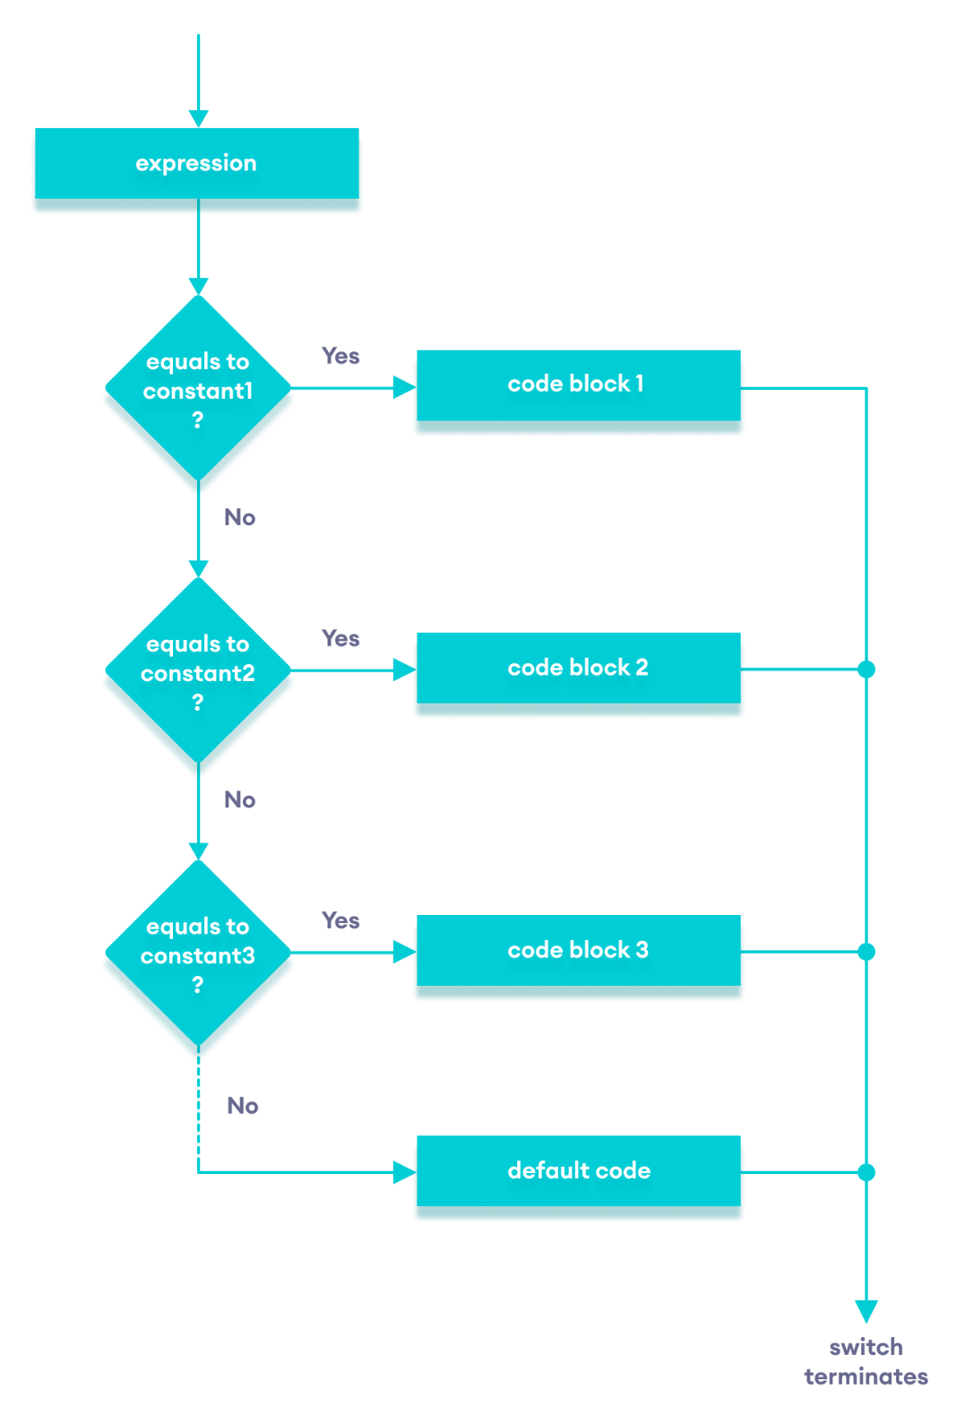

Slide 6
switch statement (without break)
Suppose ch is 'a’
switch (ch) {
case 'a': cout <<“ ch contains a”;
case 'b': cout <<“ ch contains b”;
case 'c': cout <<“ ch contains c”;
}

Slide 7
Switch – Example-1
char grade;
cin>>grade;
switch (grade)
{
case ‘A’: tution_fees *= 0.20; break;
case ‘B’: tution_fees *= 0.40; break;
case ‘C’: tution_fees *= 0.60; break;
default: tution_fees *= 1;
}

Slide 8
Switch – Example-2
int day;
cout<<“Enter day number“; cin>>day;
switch (day) {
case 1 :
case 7 : cout << "This is a weekend day";
break;
case 2 :
case 3 :
case 4 :
case 5 :
case 6 : cout << "This is a weekday"; break;
default : cout << "Not a legal day";
}

Slide 9
Conditional Operator, examples
cout << ((num % 2 == 0) ? "num is even" : "num is odd");
int min_value = (num1<num2) ? num1 : num2;
unsigned int absvalue = (n< 0) ? -n : n;

Slide 10
Today’s Lecture

Slide 11
Repetition Structure
Repetition Structure or Loops: Allows you to repeat a section of your program a certain number of times
Repeats until the condition remains true
Terminates when the condition becomes false

Slide 12
Loops in C++
for loop
while loop
do loop
Counter-controlled loop
Conditional loop

Slide 13
Loops
Counter-controlled Loops
Depends on the value of a variable known as counter variable. The counter is changed (increased/decreased) in each iteration.
Example: for loop
Conditional loop
A conditional loop keeps repeating until a specific condition is met
Example: while and do loops

Slide 14
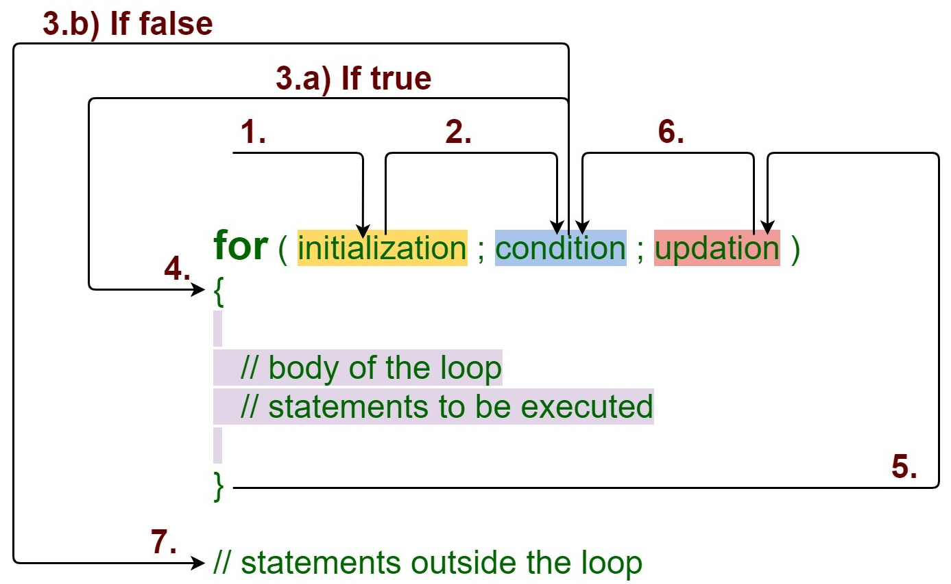
for Loop
https://media.geeksforgeeks.org/wp-content/uploads/20191108131134/For-Loop.jpg

Slide 15
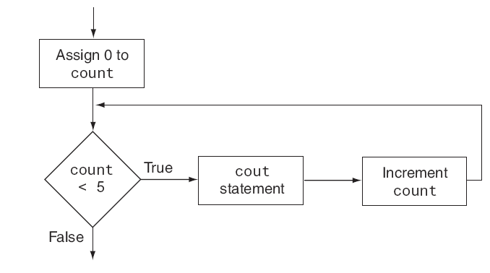
for Loop

Slide 16
for Loop - Example
for (int j=0; j<10; j++)
cout << j * j <<endl;
Initialization
expression
Test Condition
Update expression

Slide 17
(for loop) -- Class Exercise-1
- Get a number from user and calculate its factorial
This program displays the numbers 1 through 10 and their squares.
Ask user to enter a number and count how many numbers are divisible by 3 and 5

Slide 18
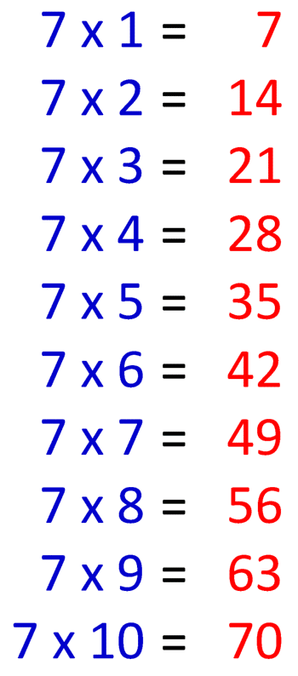
(for loop) -- Class Exercise-2
Write a program that ask the user to enter a number. The program should print the table of that number (up to 10 values). Example… Enter a number: 7

Slide 19
for loop – Multiple Expressions
for (int j=0, k=9; j<10, k>5; j++,k--)
cout << j * j <<endl;
cout<< k*k <<endl;
Multiple Increment/Dec
expressions
Multiple Initialization
expressions
Test Condition

Slide 20
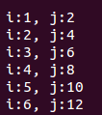
(1) for loop – Multiple Expressions
int i, j;
for(i=1,j=2; i<=3,j<=12; i++,j=j+2)
cout<<"\n i:"<<i<<", j:"<<j;
Output?

Slide 21
(1) for loop - Variable Visibility
int main()
{
int j;
for(int j=0; j<10; j++) {
k = j*j;
cout<<“\nValue of k: “<<k;
}
// j = 23; cannot do this!
return 0;
}

Slide 22
(1) for loop – optional expressions
int j=0;
for(; j<10; j++)
cout<<“\nHello world“;
int j=0;
for(; j<10;)
{
cout<<“\nHello world“;
j++;
}
for(; ;)
cout<<“\nHello world“;
Infinite loop
(it never terminates)

Slide 23

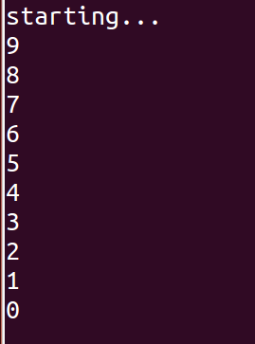
for loop
int i = 10;
for(cout<<“Starting…”;i;cout<<i<<endl)
--i;
Output?

Slide 24
References
Credit goes to Dr. Muhammad Aleem for preparation of slides
Text book: Starting out with c++

Slide 25
Thank You ☺

